Slide 1
An Unusual Case of Spastic Paraplegia
Dr. Dhaval Dave
Department of Neurology
Dr. D.Y. Patil Medical College

Slide 2
19/M
Stiffness & Weakness of both lower limbs since 4 years
Insidious onset, Gradually Progressive
Proximal to begin with
Over 6 months progressed distally
Over 1 year was able to walk only with walker
Since 2 years bedridden
Stiffness in both lower limbs since 3 years
No history of neck weakness

Slide 3
History of acute onset weakness of Rt Upper Limb 1 year back
Recovered gradually over a period of 1 month with physiotherapy
No history of any weakness in Lt Upper Limb
No stiffening or wasting in upper limbs
No history of any sensory complaints
No history suggestive of any cranial nerve involvement
No history of twitching of muscles

Slide 4
On inquiry :
Known case of Idiopathic generalized epilepsy since age of 8 months on treatment (Levipill & Lamotrigine)
Poor scholastic performance and was admitted in school of slow learners
Crying spells and aggressive behaviour intermittently since 1 year
Excessive weight gain since 2 years with purplish striae over chest and abdomen, after consuming some ayurvedic medication for 6months
Brownish large plaques over entire back, groin, inguinal area, buttocks and feet since 2 months

Slide 5
Family history : Not significant
Birth history : Normal

Slide 6
On Examination :
Cushingoid Features
Large brownish purple crusted plaques over back, inguinal area, groin, scrotum, buttocks and feet
Diagnosed as Tinea incognito with secondary inflammation

Slide 7
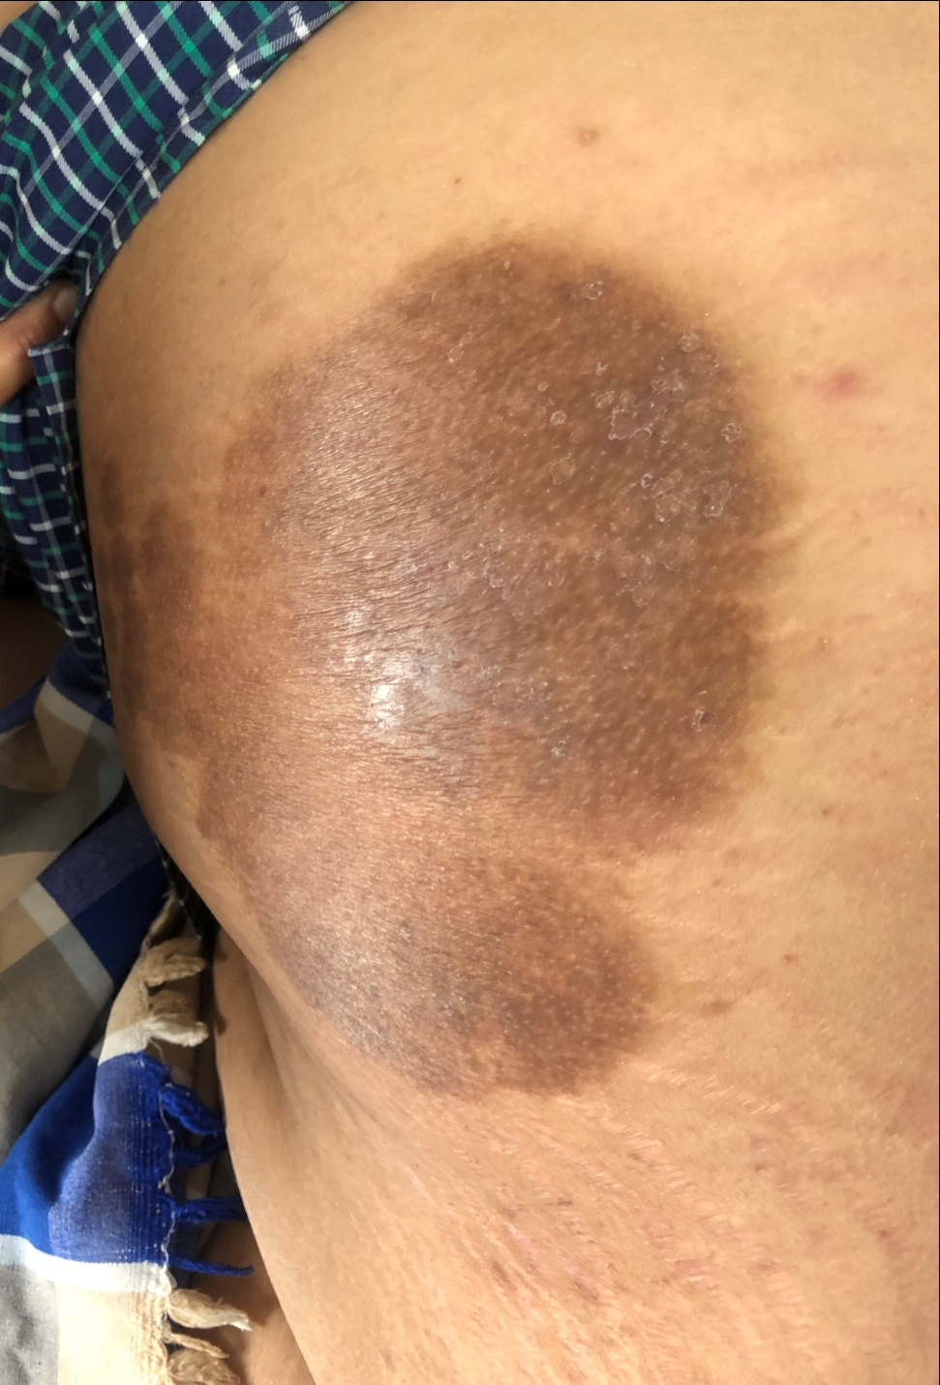

Slide 8
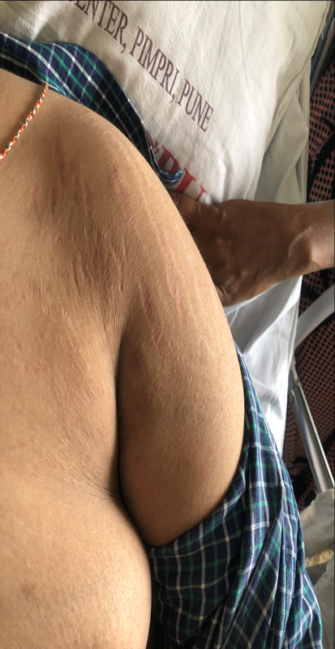

Slide 10
MMSE : 23/30
Grade 4 (MAS) spasticity in in B/L LL
Grade 1 spasticity in Rt UL
Tone normal in Lt Ul
Power : UL 5/5, LL 2/5 at all the joints in all ROM
All DTR 3+
B/L Plantars : Extensors
Tongue fasciculations present
Sensory : NAD
Gait : Could not be assessed

Slide 13
Insidious Onset, Gradually Progressive Spastic Paraparesis with epilepsy and impaired cognition with P/H Acute onset weakness of Rt UL which recovered with Cushings with tinea incognito without sensory, CN, B&B involvement
Complex Hereditary Spastic Paraparesis
Mitochondrial

Slide 14
Routine Lab Inv : Normal
Sero : Negative
MRI Brain :
Hyperintensity on Diffusion in subcortical white matter of B/L precental gyri
Altered signal intensity in b/l high fronto parietal, centrum semiovale, b/l peritrigonal & occipital periventricular white matter
Cerebral & Cerebellar Atrophy
MRI Cervical Spine with whole spine screen : No significant cord or nerve root compression

Slide 18
EMG-NCV all four limbs : Normal
ANA Blot : Negative
Lactate, Pyruvate, LDH, CPK : Normal
TSH/FSH/LH/Testosterone : Normal
Serum Cortisol : 87.36ng/ml Normal
ACTH Plasma : 22.20 pg/ml
Homocysteine : 252.2 umol/l
Homocysteine done thrice in last 4 years
497.8 / 417.3 / 215.85
Vit B12 : >2000 pg/ml
Folate : 3.60 ng/ml

Slide 19
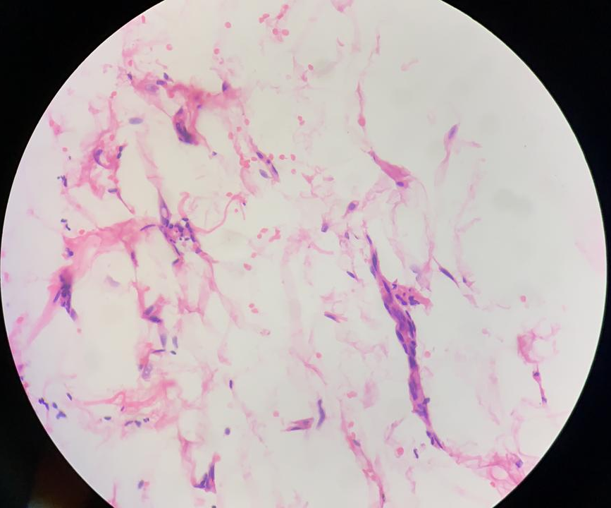
Muscle Biopsy done :

Slide 20
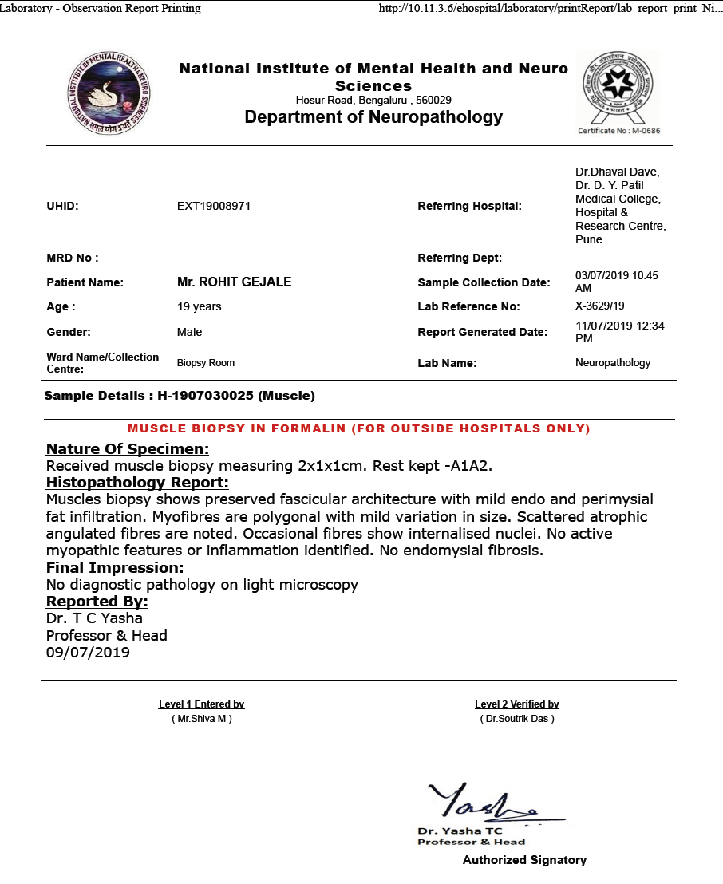

Slide 21
Methionine levels : 3.86 umol/l (Converted value : 0.04mg/dl) (Normal : 20-35mg/dl)
Heterozygous mutation in A1298C MTHFR detected
C677T : Not detected
NGS showed: Pathogenic Autosomal Recessive Compound Heterozygous MTHFR mutation in C.459C>G, C.1045T>C, & A1298C
Diagnosis : Complex HSP secondary to MTHFR deficiency (Compound Heterzygous)

Slide 22
B2, B6, B9 & B12 supplements are given in adequate dose
Betaine therapy started 6 grams/day
For spasticity so far 1200 units Botox Injection has been given at intervals of 3-4 months

Slide 23
At the end of 2years of Betaine therapy :
Homocysteine <50
No Seizures
No new focal neurological deficit
Improvement in Spasticity

Slide 24
Discussion
Hereditary spastic paraplegia (HSP) is a highly heterogeneous group of neurogenetic disorders characterized by progressive spastic weakness of the lower limbs secondary to degeneration of the corticospinal tracts.
Various forms of HSP are clinically distinguished by the presence of additional neurological and systemic manifestations, age at onset, and pattern of inheritance
To date, more than 50 distinct genetic loci and more than 30 causative genes have been identified
Despite significant progress in the diagnosis of HSP, no treatment is currently available, and about 40% of the various forms remain of unknown cause

Slide 25
Although severe MTHFR deficiency is a rare cause of complicated spastic paraparesis in adults, it should be considered in select patients because of the potential therapeutic benefit of betaine supplementation
Severe Methylenetetrahydrofolate Reductase Deficiency : Clinical Clues to a Potentially Treatable Cause of Adult-Onset Hereditary Spastic Paraplegia
Alexander Lossos, MD1; Omri Teltsh, PhD2,3; Tsipi Milman, MD2; et al
JAMA Neurol. 2014;71(7):901-904. doi:10.1001/jamaneurol.2014.116

Slide 26
Report of 2 families with severe methylenetetrahydrofolate reductase (MTHFR) deficiency, with some patients presenting with a treatable form of adult-onset HSP
Severe Methylenetetrahydrofolate Reductase Deficiency : Clinical Clues to a Potentially Treatable Cause of Adult-Onset Hereditary Spastic Paraplegia
Alexander Lossos, MD1; Omri Teltsh, PhD2,3; Tsipi Milman, MD2; et al
JAMA Neurol. 2014;71(7):901-904. doi:10.1001/jamaneurol.2014.116

Slide 27
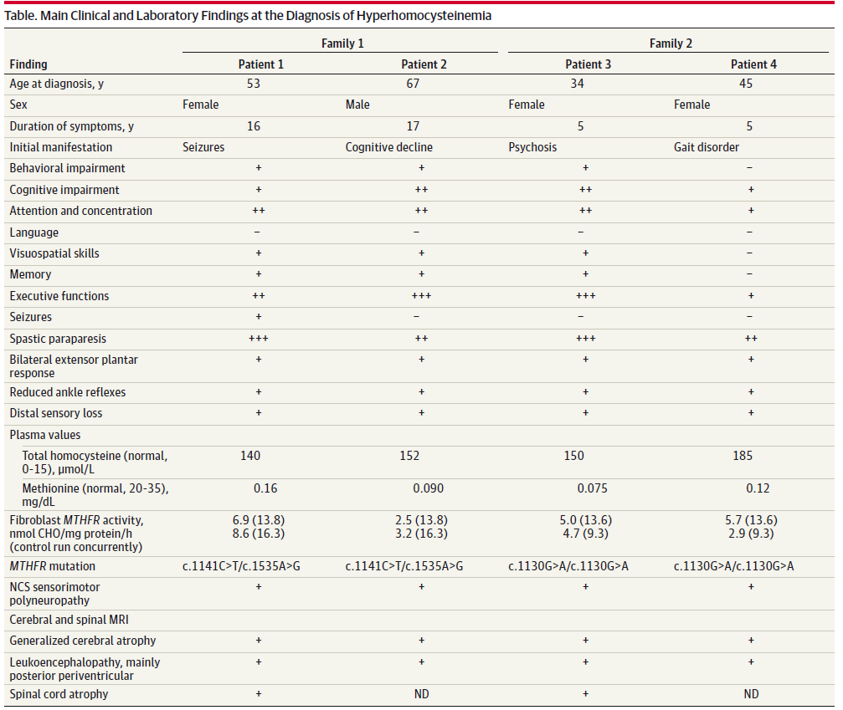

Slide 28
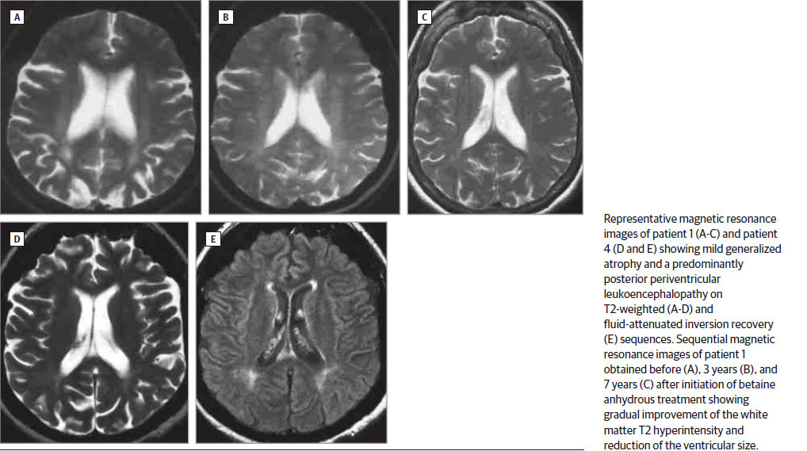

Slide 29
Whereas long axonal degeneration in the spinal cord is a common pathogenic mechanism in HSP, demyelination, as in subacute combined degeneration, underlies severe MTHFR deficiency
It is probably caused by low methionine and S-adenosylmethionine and likely results in leukoencephalopathy, of a predominantly posterior-periventricular distribution that may sometimes reverse with treatment
Severe Methylenetetrahydrofolate Reductase Deficiency : Clinical Clues to a Potentially Treatable Cause of Adult-Onset Hereditary Spastic Paraplegia
Alexander Lossos, MD1; Omri Teltsh, PhD2,3; Tsipi Milman, MD2; et al
JAMA Neurol. 2014;71(7):901-904. doi:10.1001/jamaneurol.2014.116

Slide 30
Betaine anhydrous (trimethylglycine), initiated at diagnosis of MTHFR deficiency and continued thereafter for 9 to 15 years at doses of 6 to 10 g/d, resulted in a rapid and sustained decline in homocysteine levels by 50% to 70% and in elevation of methionine level to within normal range
Over years, this was associated with additional cognitive improvement and increased walking distance of the 3 ambulatory patients who became functionally independent, with stabilization of the cerebral magnetic resonance imaging findings in 2 patients
Severe Methylenetetrahydrofolate Reductase Deficiency : Clinical Clues to a Potentially Treatable Cause of Adult-Onset Hereditary Spastic Paraplegia
Alexander Lossos, MD1; Omri Teltsh, PhD2,3; Tsipi Milman, MD2; et al
JAMA Neurol. 2014;71(7):901-904. doi:10.1001/jamaneurol.2014.116

Slide 31
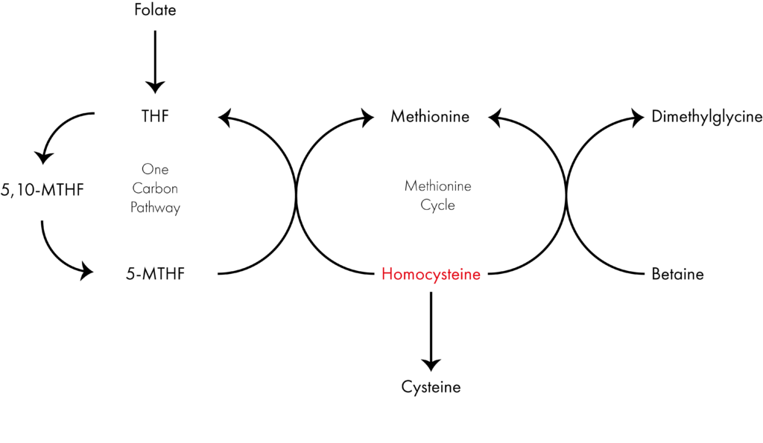
The beneficial effect of betaine in severe MTHFR deficiency is mediated through betaine-homocysteine methyltransferase with the use of an alternate methyl donor for remethylation of homocysteine to methionine
Severe Methylenetetrahydrofolate Reductase Deficiency : Clinical Clues to a Potentially Treatable Cause of Adult-Onset Hereditary Spastic Paraplegia
Alexander Lossos, MD1; Omri Teltsh, PhD2,3; Tsipi Milman, MD2; et al
JAMA Neurol. 2014;71(7):901-904. doi:10.1001/jamaneurol.2014.116

Slide 32
Conclusion
Increased awareness of the possibility of severe MTHFR deficiency and screening for total homocysteine and methionine is indicated in select patients with adult-onset complicated HSP

Slide 33
Thank You

